Slide 1
Cactus – Track 2 Chat With Scientific Document
Team Members :-
Jenil Jaiswal 21bce093
Prem jobanputra 21bce099
Bhavy masalia 21bce145
Shubh Ranpara 21bce248
Ronak siddhpura 21bce540

Slide 2
Utilizing Large Language models for Document Question Answering
We have developed a web app powered by LLMs, that takes pdf, ppt, and doc files, reads text from them, and generates a knowledge base.
We can ask questions from this knowledge base.
We have used Gemma-2b-it (Gemma 2 Billion Instruct) hugging face open source transformer as LLM.
Gemma is a family of lightweight, state-of-the-art open models from Google, built from the same research and technology used to create the Gemini models. They are text-to-text, decoder-only large language models, available in English, with open weights, pre-trained variants, and instruction-tuned variants. Gemma models are well-suited for a variety of text generation tasks, including question answering, summarization, and reasoning. Their relatively small size makes it possible to deploy them in environments with limited resources such as a laptop, desktop or your own cloud infrastructure, democratizing access to state of the art AI models and helping foster innovation for everyone.

Slide 3
Multiple file type support
Our system can support .pdf, .docx and .pptx file types.
These file types will be converted into .pdf files and then text extraction will be performed.
From the extracted text we will be embedded with HuggingFaceEmeddings.
In the context of language models (LLMs), embeddings refer to vector representations of words, phrases, sentences, or documents in a continuous vector space. These embeddings capture semantic information about the text, allowing the model to understand relationships between words and extract meaningful features for various natural language processing (NLP) tasks.

Slide 4
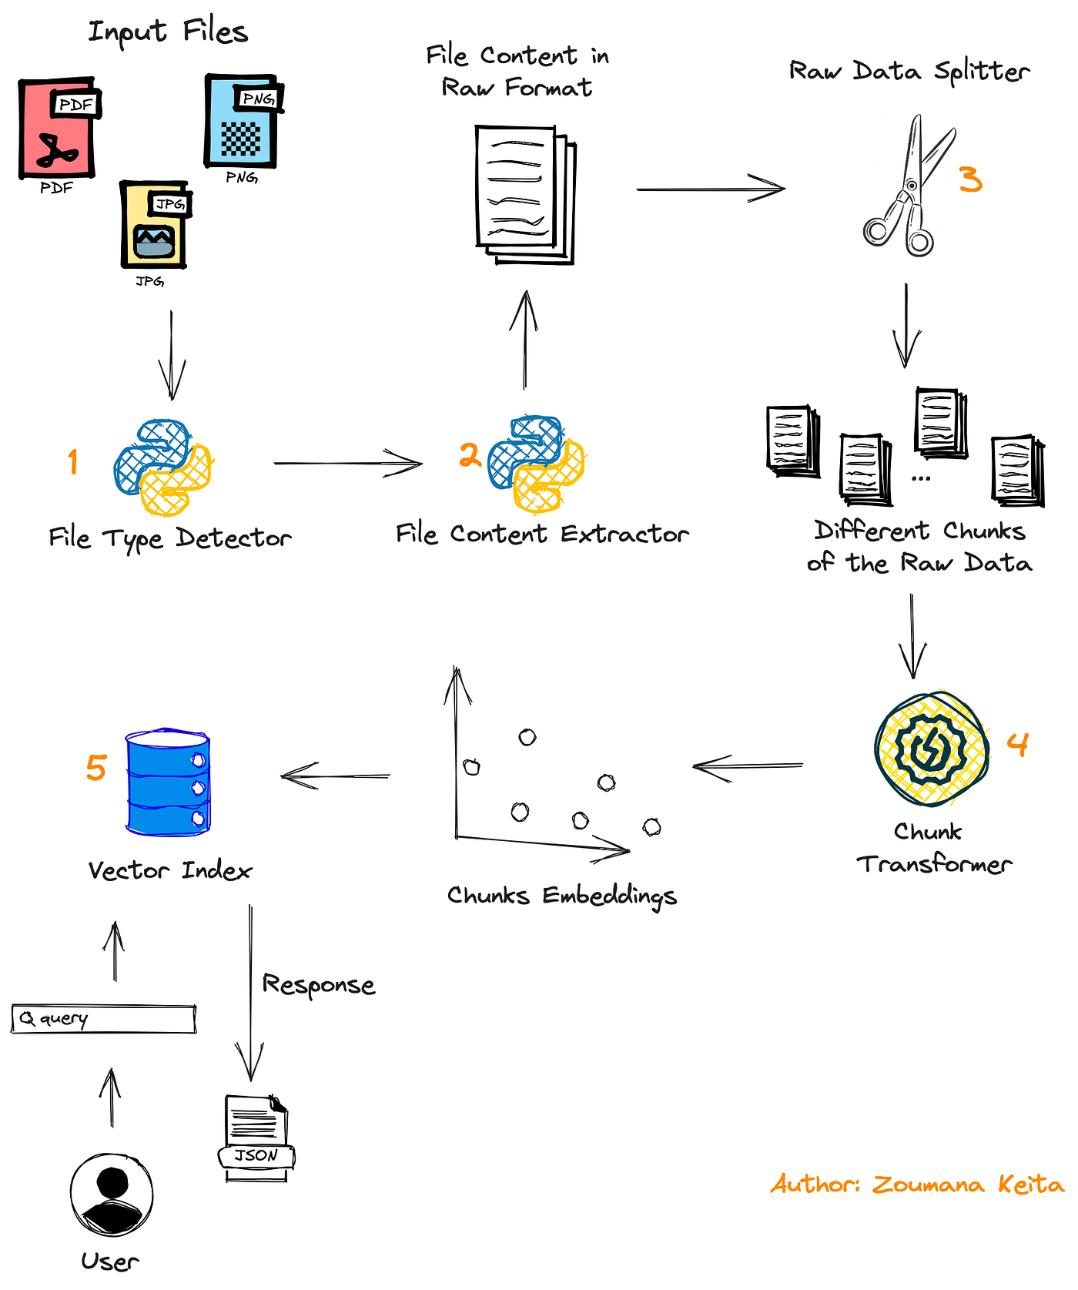


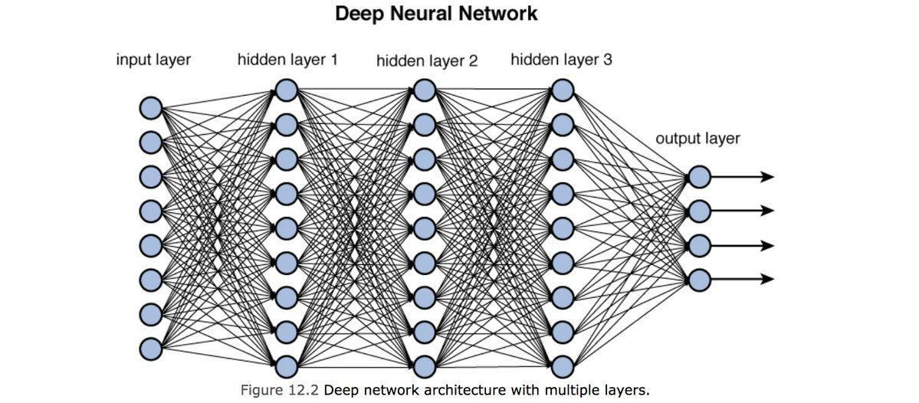
Working of our system
PPTX
DOCX
LLM
https://miro.medium.com/v2/resize:fit:1400/1*jMAGouB3s_LA1YoslX5Z_A.png
TEXT

Slide 5
References :
https://huggingface.co/google/gemma-2b-it

Slide 6
Thank you

